Slide 1
BankAccount Trace
Group T01-03

Slide 2
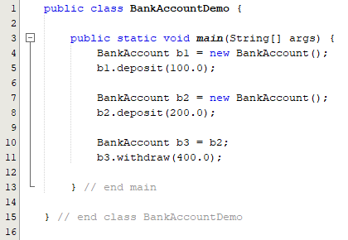
Line 4 creates a new instance of BankAccount with the name b1.
balance variable is automatically initialized to 0.0.
overdraftAmount variable is initialized to 100.0

Slide 3
The instance of b1 calls the method ‘deposit’ from the class bankAccount.
The balance instance variable belonging to b1 is increased by a value of 100.0.

Slide 4
Line 7 creates a second instance of BankAccount with the name b2.
b1 and b2 are separate and distinct objects.
b2 now creates a new instance of balance and overdraftAmount, initialized to 0.0 and 100.0 respectively.

Slide 5
The instance of b2 calls the method ‘deposit’ from the class bankAccount.
The balance instance variable belonging to b2 is increased by a value of 200.0.

Slide 6
b3 copies the reference of the memory location of b2.
Note that b3 and b2 both point to the same object.

Slide 7
The instance of b3 calls the method ‘withdraw’ from the class bankAccount.
The balance instance variable does not change from the value of 200.0. This is because it is try to withdraw a greater amount than the original balance plus overdraft amount.

